Slide 1
Data Manipulation with Pandas
Learning Objectives
Construct Pivot tables in Pandas.
Time series manipulation.
Stream data into Pandas to handle data size problems
Expected Prior Knowledge
Experience of working with data using Data Analysis tools such as Excel.

Slide 2
Pivot Tables

Slide 3
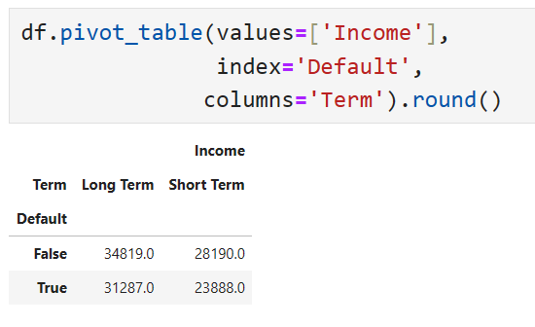
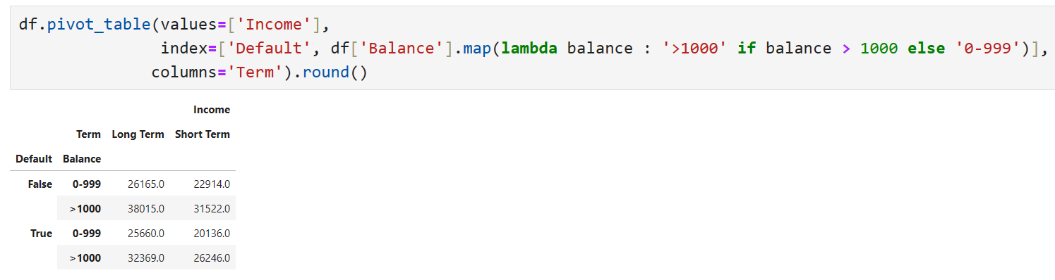
Pivot_table can be used to construct Excel style pivot tables in pandas
View statistics across category groups
Creating Pivot Tables
Notes:
Pandas has a pivot_table function which provides spreadsheet style pivot tables for DataFrames. Row indices can be specified using the columns parameter, and can be multivalued, and the columns can be specified using the values parameter.
If multiple columns are specified, multiindexing is required to select subsets.

Slide 4
Time Series

Slide 5
Time data provides unique challenges:
Unique mathematical rules
Different formats
Periods at can be defined at multiple levels
E.g. seconds, hours, days, weeks etc.
Time zones
Pandas has tools to handle these issues
Time Data

Slide 6
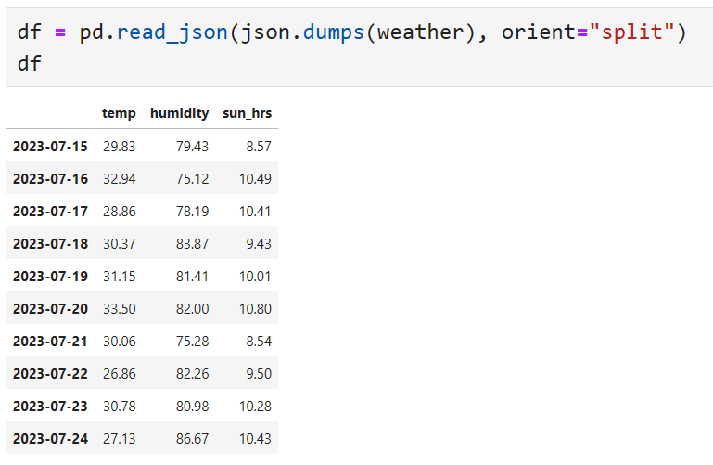
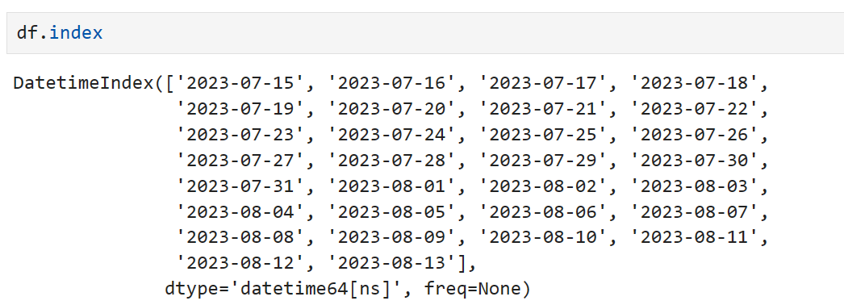
Indexing By Time
Notes:
Python itself has a rich set of modules and datatypes which are used to represent dates & times – namely the datetime module and the datetime type.
When reading files, pandas errs on the side of caution when parsing date and time data, preferring to read it into an object type and leave conversion to a datetime type to you.
Pandas converts datetimes into the numpy datetime64 type at nanosecond resolution, though others can be specified.
It is possible to set the index of a Dataframe or Series to a sequence of datetimes by setting the index parameter when creating the object, or setting the property after creation.

Slide 7
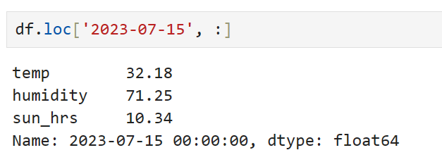
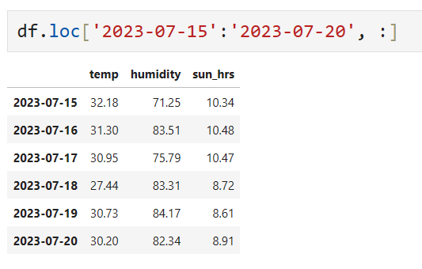
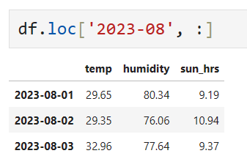
Slicing by Time
Notes:
Datetimes, like other types, can be sliced using loc. This is done by passing a string which is parsed to a datetime. Depending on the granularity of the string you pass, you can select single or multiple values by passing a single index e.g. “2001” would return all values with a timestamp from the year 2001.
We can also use python datetimes to index.
Slicing is done using the same notation as with typical indices.
Beware of duplicate index values, which pandas can handle, and can be checked for using is_unique.

Slide 8
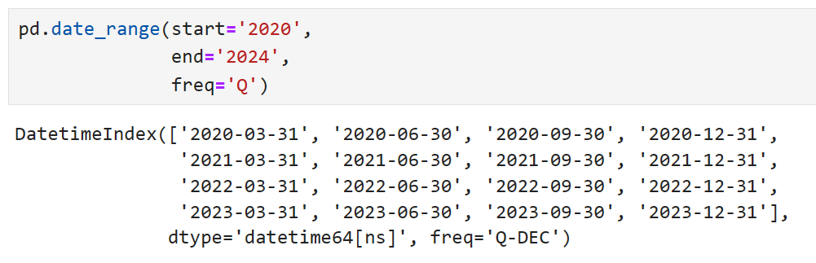
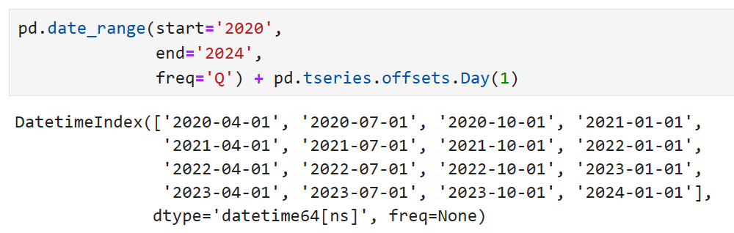
Offsets & Frequencies
Date ranges can be defined very flexibly
Using pandas offsets, we can add intervals to times
Notes:
The date_range function can be used to define ranges of Datetimes, and is incredibly dynamic when defining “steps” or offsets.
Arithmetic operators can be used to define sums and multiples of offsets.
Leading and Lagging can be done using the shift method, which preserves the index but moves values either forwards or backwards a number of steps.

Slide 9
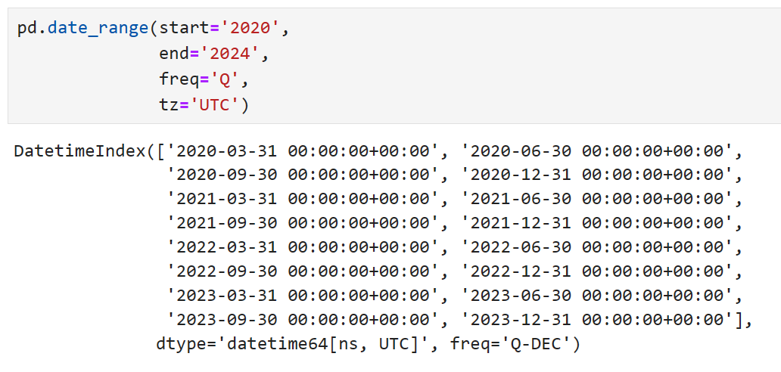
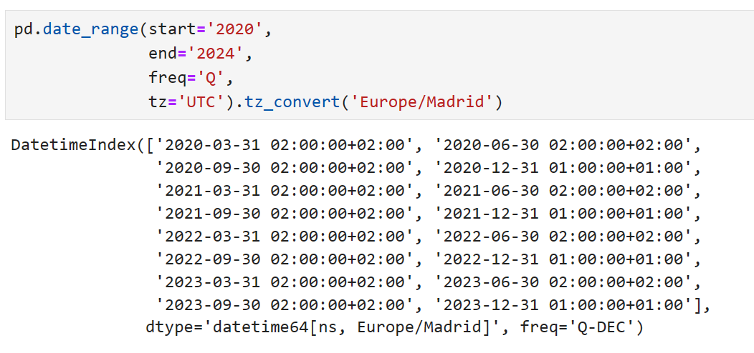
Dealing with Time Zones
Notes:
In Python, time zone information comes from the third-party pytz library (installable with pip or conda), which exposes the Olson database, a compilation of world time zone information. This is especially important for historical data because the DST transition dates (and even UTC offsets) have been changed numerous times depending on the regional laws.
To localize to UST, use the tz_localize method. After localization, conversion to datetimes at specific locations is possible.

Slide 10
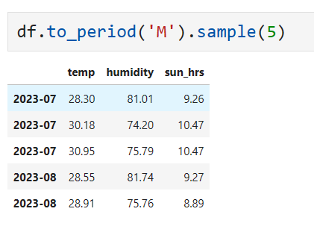
Time Periods
Datetimes can be converted to periods
E.g. Months
Index doesn’t need to be unique!
Multiple values returned at for each period
Notes:
Periods refer to nonoverlapping time spans, and timestamp can only belong to a single period for a given frequency. We use the to_period method to reindex a series to a period.
PeriodIndex can be used to merge time information from across multiple columns and produce a compound index.

Slide 11
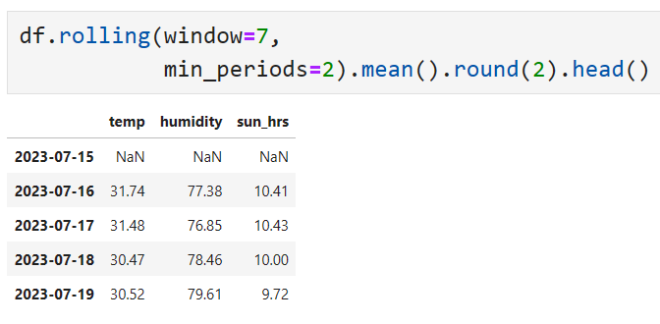
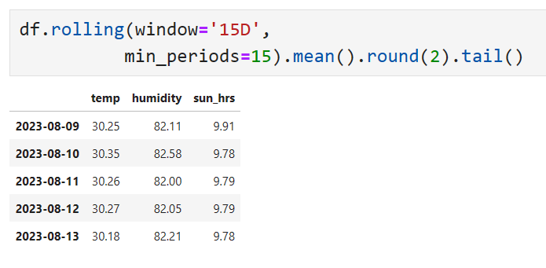
Window functions allow evaluation over sets of rows
Windows can be static row sets or dynamic periods
Moving Window Functions
Notes:
It is common to apply rolling or window functions over a column for a certain time period. DataFrames do this by implementing the rolling method, which allows a function to be applied over a set of consecutive rows. Rolling also permits time period strings to be passed e.g. “20D” would apply the function over a 20 day window, rather than a static count of rows.

Slide 12
Streaming Data

Slide 13
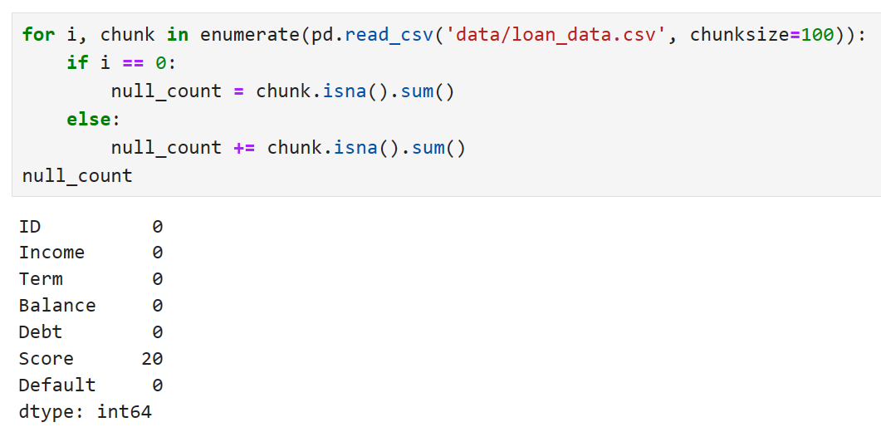
Streaming large files
When a file is too large (≈ RAM), don’t process all at once
Read functions allow chunks to be read in
File processed N rows at a time
Need to work iteratively
Notes:
Pandas, being a Python library, is constrained to working on data sets whose size does not exceed the memory of the machine the process is running on. This will limit the size of file which can be effectively handled by Pandas.
Realistically, work on large files and datasets is an engineering consideration and will likely be handled by leveraging cloud tools, “Big data” tools, or use of advanced hardware. If that isn’t an option, Pandas does offer a solution. It is possible to stream data into Pandas by setting the chunk_size parameter of the read function being used. This will load a subset of the file into a DataFrame to be worked on.
For this to work, all computation is done by iteration through each chunk.

Slide 14
Combining Tables

Slide 15
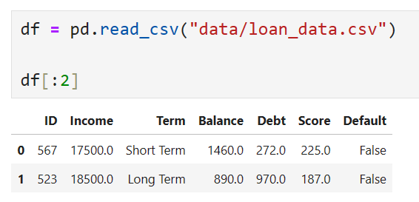
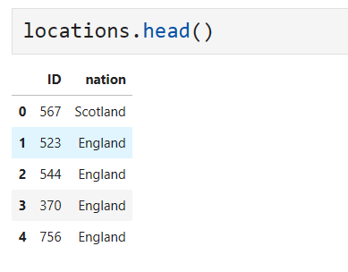
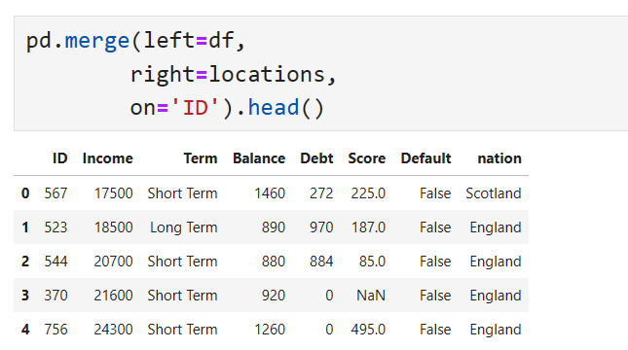
Merge allows for SQL like joins between DataFrames
Used to combine tables based on condition
Merging DataFrames
Notes:
The merge function offers SQL like join support between dataframes. It is possible to join dataframes by equality of value, and specify the type of join to be applied.

Slide 16
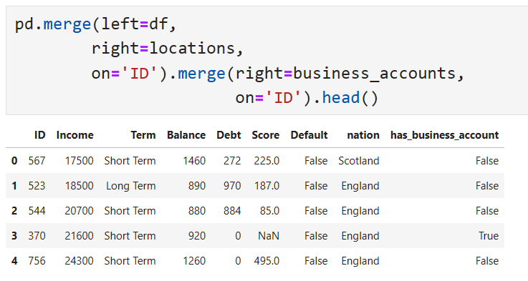
Chained merges join further tables
Merging Multiple DataFrames
Notes:
By chaining merges, we can join multiple DataFrames together.

Slide 17
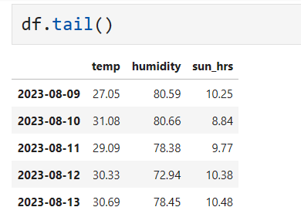
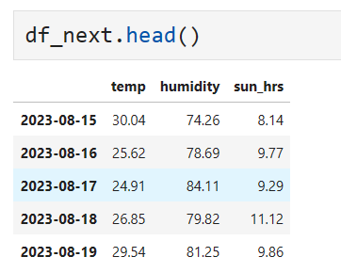
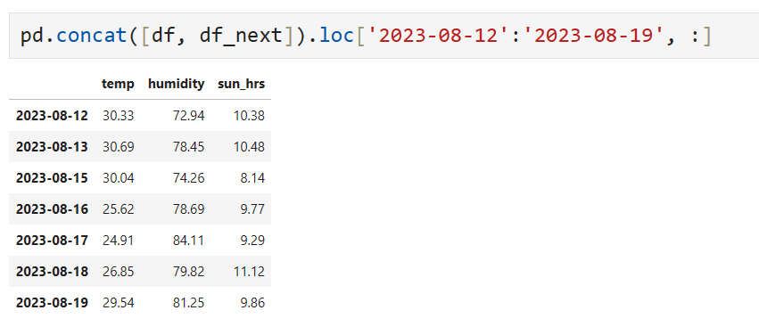
Concat sticks DataFrames together without a conditon
Concatenating DataFrames
Notes:
Concat allows dataframes to be stuck together along row or column axes.

Slide 18
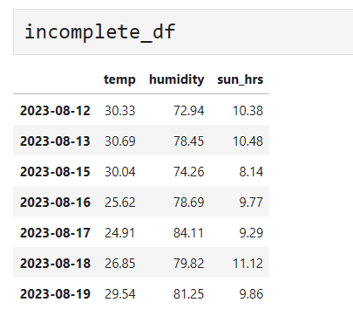
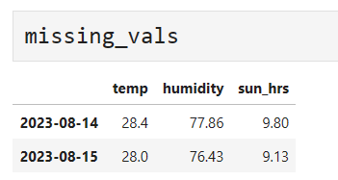
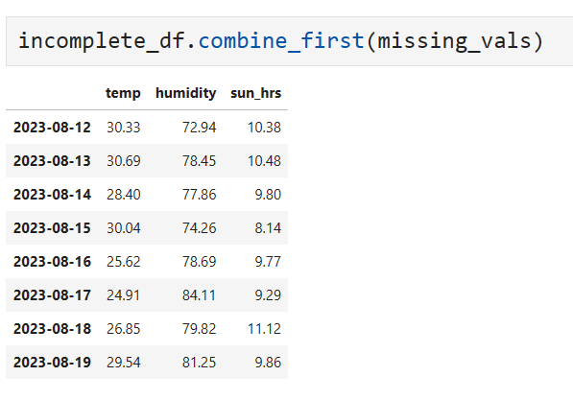
Used to fill in gaps in indices
Splicing Together DataFrames
Notes:
Combine_first can be used to splice DataFrames together using their respective indices, and filling in values where found.

Slide 19
07_Data_Manipulation_with_Pandas_Exercise.docx
Exercise

Slide 20
Learning check
Think about your answers to these questions
What do Pivot tables do?
What are common time data problems?
What does Pandas offer to deal with large files?

Slide 21
How did you get on?
Learning Objectives
Construct Pivot tables in Pandas.
Time series manipulation.
Stream data into Pandas to handle data size problems

